Slide 1
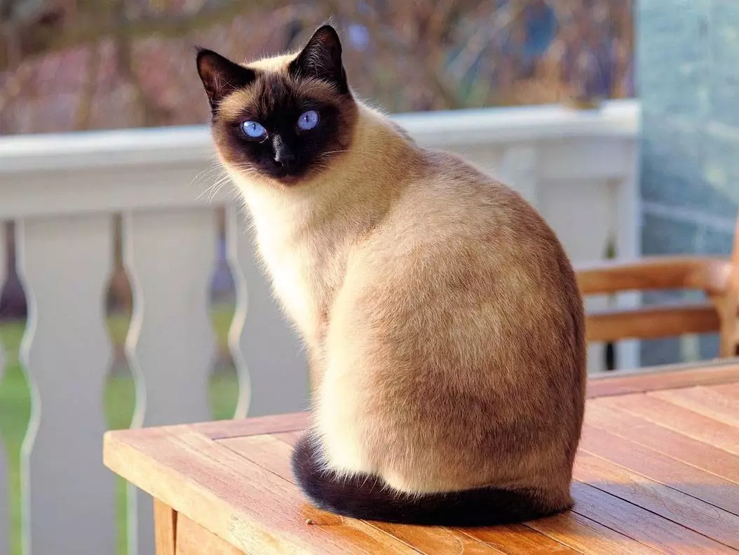
Siamese Networks

Slide 2
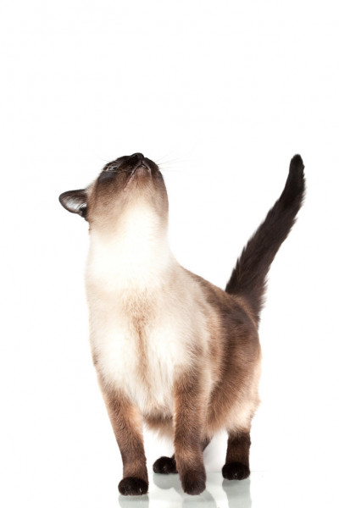
Agenda
What are Siamese Networks
01
Loss Functions
02
Demos
03
Clothing Recommendation
04
History and Implementation
Triplet vs Contrastive Loss
Walkthrough on MNIST and Fashion MNIST
Using a Siamese Network

Slide 3
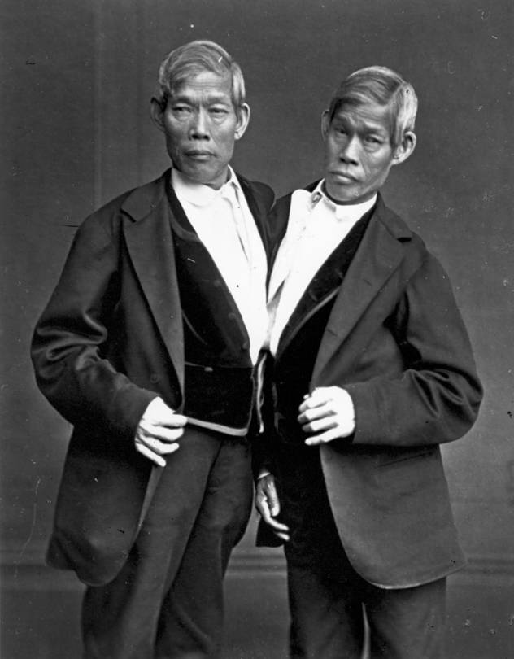
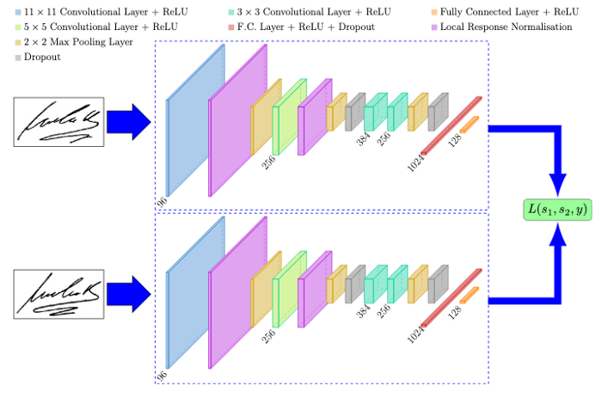
What are Siamese Networks?
Chang and Eng Bunker - 1865
Example of a Siamese Neural Network - Signet
Weight gets updated in one network it will get updated in the sister network
Conjoined (Siamese) twins are physically born connected to one another and often share the lower intestinal tract.
Siamese networks are a type of neural network architecture type that contains two or more identical subnetworks (sister networks): They are independent, the weight updates are also identical.

Slide 4
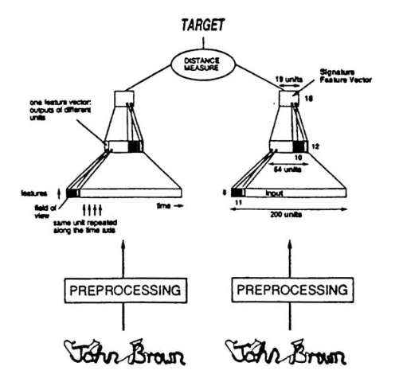
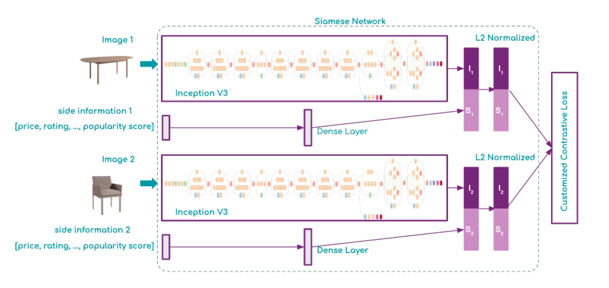
History of Siamese Networks + Applications ?
Bromley and LeCun - 1994
Wayfair uses Siamese Networks for item recommendation
The original conception of Siamese Networks was devised to solve signature verification as an image matching problem
Other use cases:
FaceNet: Face recognition system developed in 2015 by researchers at Google Pedestrian tracking for video surveillance Cosegmentation: The simultaneous segmentation of similar foreground objects from two (or more) images. Comparing Molecular Structures: Etc

Slide 5
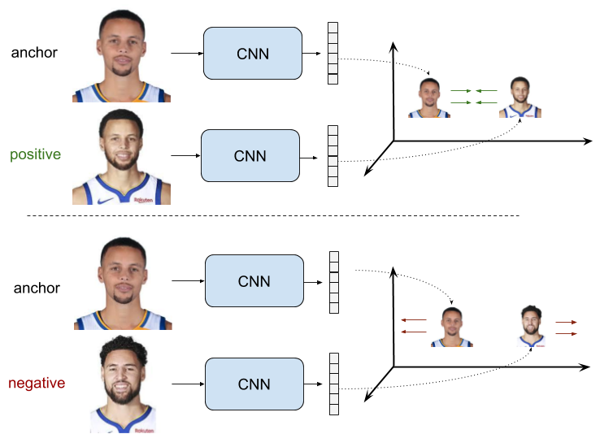
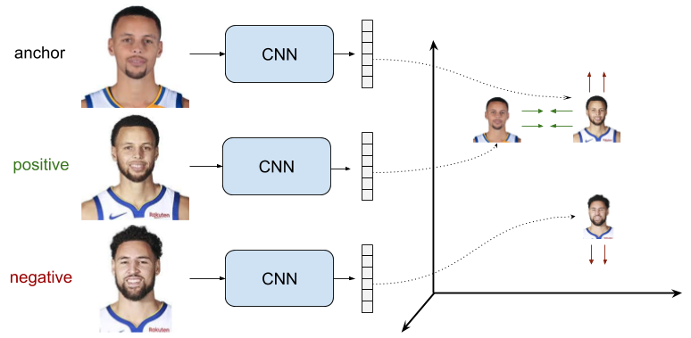
Siamese Network - Loss Functions
The loss function determines how images will be fed into the network
Contrastive Loss
Triplet Loss
The loss is low if positive samples are encoded to similar (closer) representations and negative examples are encoded to different (farther) representations.
The objective is that the distance between the anchor sample and the negative sample representations is greater than the distance between the anchor and positive representations

Slide 6
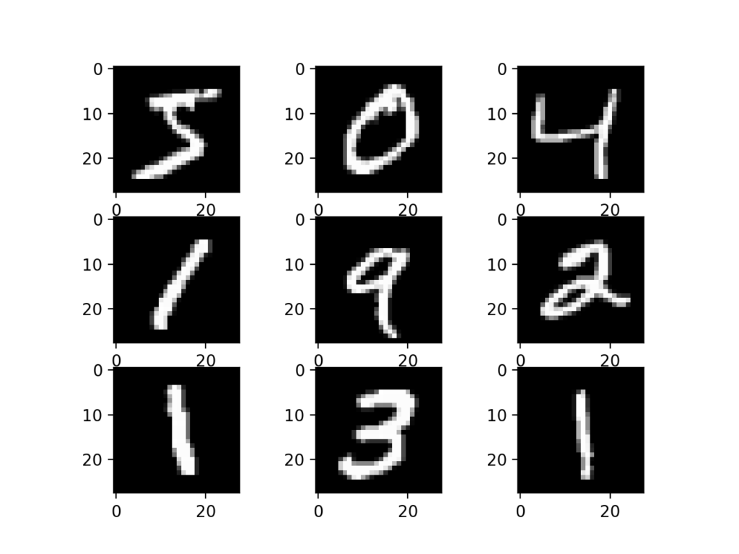

MNIST - Triplet Loss

Slide 7
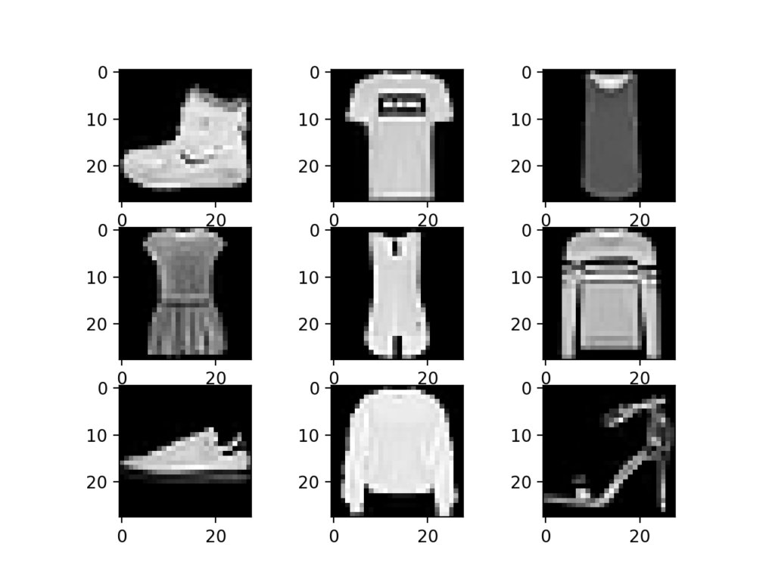
Fashion MNIST - Contrastive Loss

Slide 8
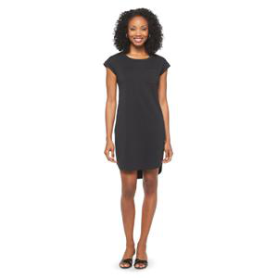
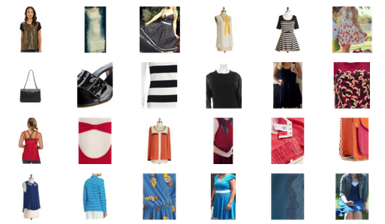
Clothing Recommendation Network
Image from Dataset
Model Output
We will be using Siamese Network on clothing data to generate the closest image pair. 90,112 total images.
Model displaying the 5 nearest items based on the original image on the left hand side.

Slide 9
Thanks!

Slide 10
References
https://colab.research.google.com/github/gofynd/mildnet/blob/master/MILDNet_on_Colab.ipynb#scrollTo=tofXA2xaUoZv
https://arxiv.org/pdf/1901.03546.pdf
https://github.com/omoindrot/tensorflow-triplet-loss/blob/master/train.py
https://keras.io/examples/vision/siamese_network/
https://towardsdatascience.com/the-w3h-of-alexnet-vggnet-resnet-and-inception-7baaaecccc96
https://medium.com/vitrox-publication/understanding-circle-loss-bdaa576312f7
https://console.cloud.google.com/storage/browser/fynd-open-source/research/MILDNet;tab=objects?prefix=&forceOnObjectsSortingFiltering=false&pageState=(%22StorageObjectListTable%22:(%22f%22:%22%255B%255D%22))
https://github.com/gofynd/mildnet

